Slide 1



SQL for Data Science
Day 2

Slide 2
Quick Recap – Relational Databases
Data Sources: Can be structured (tabular) or unstructured (images, videos, text, etc.)
Relational databases are a collection of related tables.
Database schemas stores information about the individual tables and documents the database structure

Slide 3
Quick Recap – Entity Relationship Diagrams
Relationships between individual tables are depicted using Entity-Relationship-Diagrams (ERDs)
This graphical representation of the database’s structure captures types of relationships and level of details of each table within the database

Slide 4
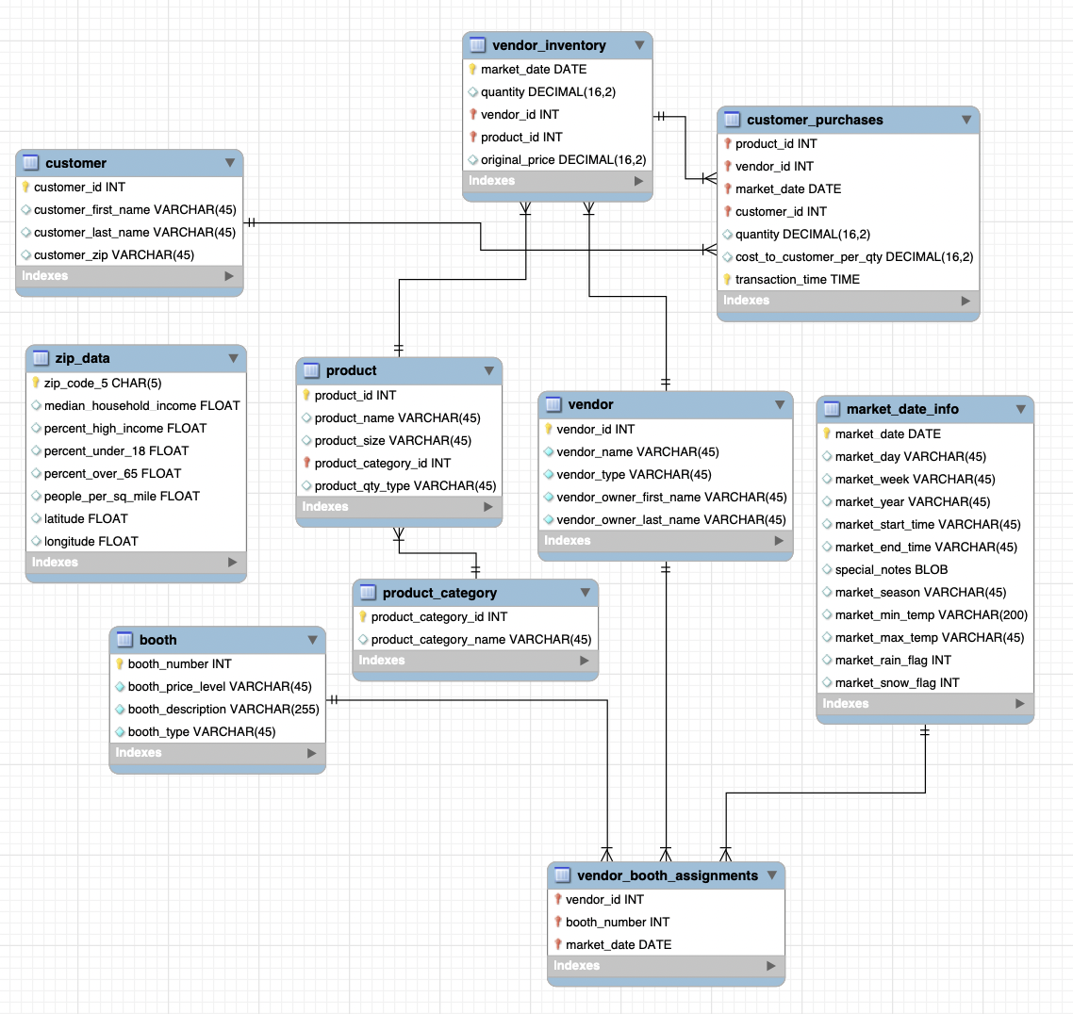

Slide 5
Reverse-Engineering an ERD from a database
Open MySQL to the connection containing the database
Click on Database > Reverse Engineer
Select the relevant stored connection > select database

Slide 6
Quick Recap – ERD Cardinalities
<
One to Many
One to One
One to One (and only one)
One to Zero or One
<
One to One or Many
<
One to Zero or Many

Slide 7
Quick Recap – SQL Query Structure
SELECT [columns to return]
FROM [database.table_name]
WHERE [conditional filter statements]
GROUP BY [columns to group on]
HAVING [conditional filter statements run after grouping]
ORDER BY [columns to sort on]

Slide 8
Quick Recap – SQL in-line calculations
As part of the SELECT statement, you can do simple calculations using values in other columns and return the results as a new column
SELECT col_a, col_b, col_a * col_b AS product
FROM database.table_name

Slide 9
Quick Recap – SQL Functions
An SQL Function is a piece of code that takes in some parameters and returns a result.
FUNCTION_NAME([parameter 1], [parameter 2] …)
ROUND(col_a, 2)
CONCAT(col_b, “ “, col_c) AS MERGED_COL

Slide 10
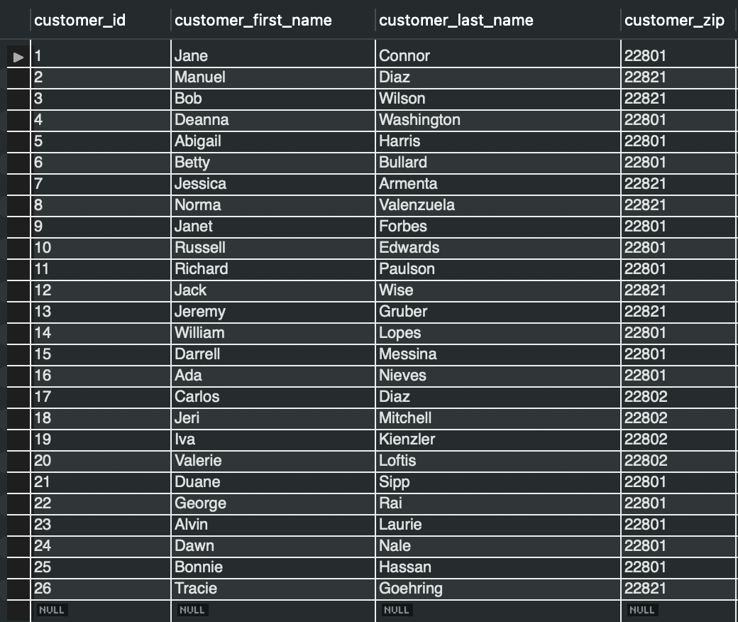
Solutions to Homework Problems
Write a query that returns everything in the customer table.
SELECT * FROM farmers_market.customer

Slide 11
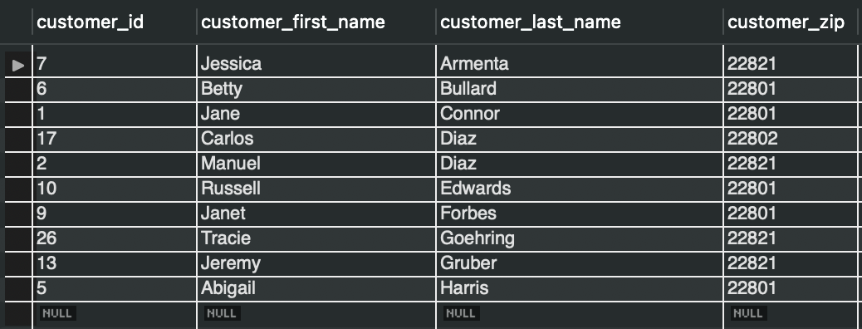
Solutions to Homework Problems
Write a query that displays all of the columns and 10 rows from the customer table, sorted by customer_last_name , then customer_first_name
SELECT *
FROM farmers_market.customer
ORDER BY customer_last_name,
customer_first_name
LIMIT 10

Slide 12
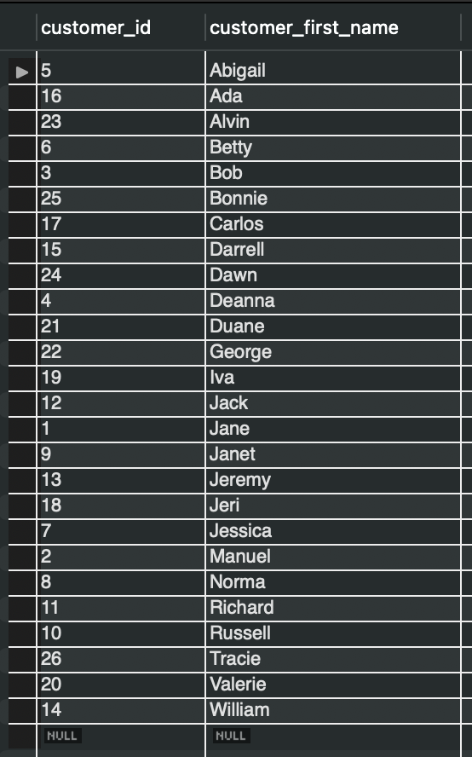
Solutions to Homework Problems
Write a query that lists all customer IDs and first names in the customer table, sorted by first_name
SELECT customer_id,customer_first_name
FROM farmers_market.customer
ORDER BY customer_first_name

Slide 13
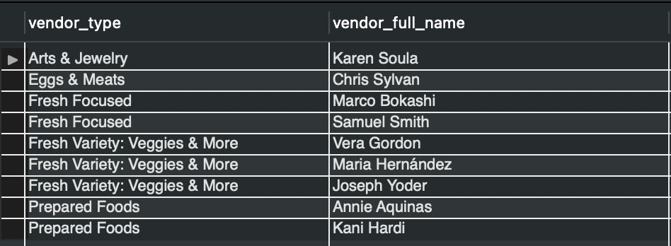
Solutions to Homework Problems
Write a query that displays the FULL NAME of the vendors from the vendor table in a column called "Vendor Full Name" along with the vendor_type column. Sort the table by the vendor type, then the vendor's last name.
SELECT vendor_type,
CONCAT(vendor_owner_first_name, " ", vendor_owner_last_name) AS vendor_full_name
FROM farmers_market.vendor
ORDER BY vendor_type, vendor_owner_last_name

Slide 14
Quick Recap – SQL Query Structure
SELECT [columns to return]
FROM [database.table_name]
WHERE [conditional filter statements]
GROUP BY [columns to group on]
HAVING [conditional filter statements run after grouping]
ORDER BY [columns to sort on]

Slide 15
The WHERE clause
The WHERE clause is used as part of a SELECT statement that is used to determine which rows should be included in the results a.k.a. filtering
Similar to IF statements in other programming languages, SQL also uses Boolean logic (AND/OR) to determine the action to take

Slide 16
The WHERE clause
The WHERE clause goes after the FROM statement, before the GROUP BY, ORDER BY or LIMIT statements in the SELECT query. The conditions being applied use regular algebraic expressions including but not limited to ”=“, “<”, “>” and combinations thereof.
SELECT *
FROM farmers_market.table
WHERE customer_id = 1
LIMIT 5

Slide 17
Filtering on Multiple Conditions
You can combine multiple conditions with Boolean operators such as AND, OR, or AND NOT between them in order to filter using multiple criteria in the WHERE clause
SELECT *
FROM farmers_market.table
WHERE customer_id = 1 OR customer_id = 3

Slide 18
Filtering on Multiple Conditions
You can also combine multiple AND, OR and NOT conditions, and use parentheses the same way as you would in algebraic expressions to specify the order of operations
The conditions inside the parentheses will be evaluated first
WHERE clauses can also impose conditions using values in multiple columns

Slide 19
BETWEEN
In order to specify a conditions that need to check if a value lies within a certain range, you can use the BETWEEN keyword.
SELECT *
FROM table
WHERE
col_a = 7
AND date BETWEEN ‘2019-03-02’ and
’2019-03-16’

Slide 20
IN
You can also use the IN keyword to determine if the value in a column belongs to a list
SELECT *
FROM table
WHERE
customer_name IN (‘Diaz’, ‘Edwards’, ‘Wilson’)

Slide 21
LIKE
The LIKE keyword allows you to search for strings that partially match a given condition. This is super useful when dealing with “dirty data”
If the name you were searching for was Jeremy but were unsure how it was spelt, you will be able to find all results that match the first three letters
SELECT *
FROM table
WHERE
customer_name LIKE ‘Jer%’

Slide 22
IS NULL
You can use the IS NULL keyword to find rows where the field is NULL. Note that “blank” entries are not the same as NULL. Blank entries could simply be an empty string ‘’ (two quotes with nothing in between)
SELECT *
FROM table
WHERE size IS NULL

Slide 23
IS NULL
Note the use of “IS NULL” and not “= NULL”. NULL is not a value, but the absence of a value and can therefore not be compared. Nothing can “equal” NULL, including NULL.
In order to find values that are not empty, you can combine the NULL keyword with NOT.
SELECT *
FROM table
WHERE column IS NOT NULL

Slide 24
TRIM - Function
Sometimes data can be dirty, and an empty value could be listed as ‘’, or ‘ ‘. In order to capture all missing values, you can use TRIM, which removes excess spaces from the beginning or end of a string

Slide 25
Filtering using Subqueries
Imagine you wanted to filter based on the results of another query. This is useful when you don’t have a hard-coded list of values to filter on
SELECT *
FROM table
WHERE
column IN
(
SELECT column
FROM table_b
WHERE column = 1
)

Slide 26
CASE Statements
Sometimes, you may want to return a column whose values are based on a conditional statement. A where statement helps you filter rows using conditional statements. The Case statement allows you to generate new columns based on conditions.

Slide 27
CASE Statements
Imagine we want a column that contains different values under different conditions:
CASE
WHEN weather_forecase = ‘rain’
THEN ‘take umbrella’
ELSE ‘leave umbrella at home’
END

